Slide 1

Caregiving Adversity & Internalizing Symptoms in Youth: Role of Gut Microbiome Functional Potential
Fran Querdasi & Naomi Gancz
Goodman-Luskin Microbiome Center Symposium
April 4, 2024
Notes:
Brain and Body lab figure can def be swapped out!
Defining the sample – who are they and characteristics of experiences, justifying why looking in that group
Why looking at SCFAs and AAs

Slide 2
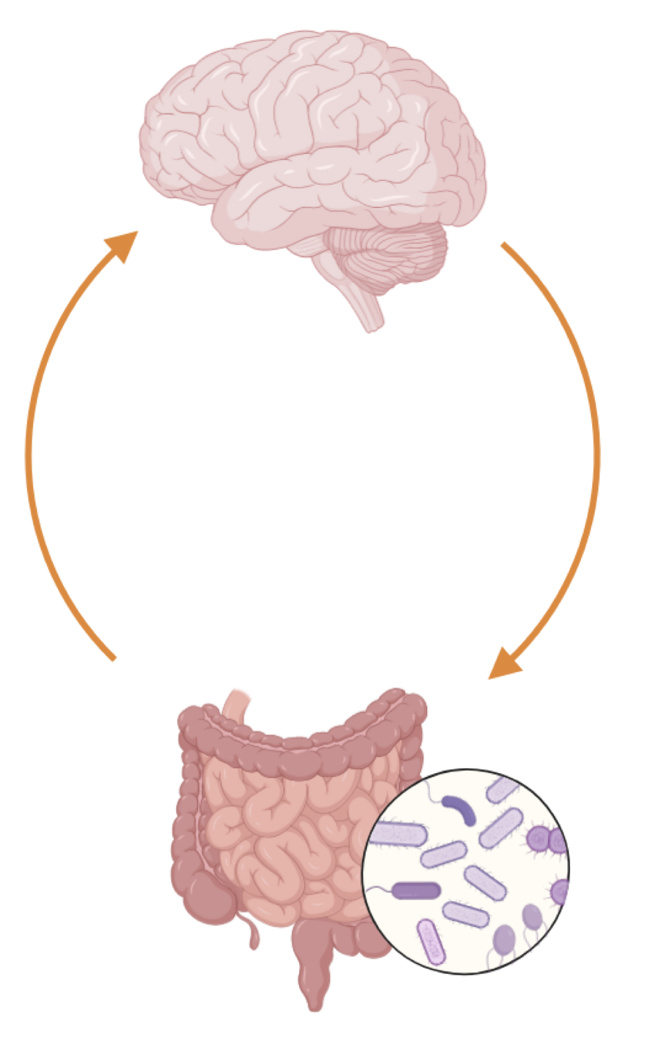


Introduction
U.S. Children’s Bureau (2022); O’Donnell & Meaney (2017); Juffer et al (2005); Eckshtain et al. (2020); Cuijpers et al. (2021)
Notes:
Sense of attachment/security depends on relationship w/caregiver
When disrupted, such as in adoption/foster care, this is CA; -> multisystem dysregulation
Very common, ~100k adopted and 400k in foster each year
CA -> internalizing symptoms (anxiety/depression-like, often accompanied by fatigue/gi symptoms)
But evidence-based treatments for internalizing disorders like depression only 40—60% effective
Can gut mb dysregulation yield info about potential alternative/adjunct treatments?

Slide 3




Introduction
Short-chain fatty acids
Amino acid metabolism
Kelly (2016); Zheng (2016); Querdasi et al. (2023); Callaghan et al. (2019)
Notes:
Microbiome seems to regulate internalizing; example: fmt from mdd humans to rodents induces internalizing-like behaviors accompanied by altered SCFA and AAA
Additionally, CA seems to induce some of these changes, especially decreased SCFA
We see alterations in these metabolites replicated in some observational work with humans using taxonomic data
But there is a scarcity of data from children/adolescents and of functional data as well

Slide 4




Methods
Age 6-16
N=57
Caregiving Adversity
N=68 Comparison
Notes:
CA = adopted into stable care from intntl/foster care (1 sub reclassified)
Really great sample because CA is past but effects are lingering, and because this CA type is v common
Age 6-16, encapsulates internalizing peak onset
Stool shotgun metagenomics biobakery workflows
Targeted analysis of SCFA/AAA, and exploratory analysis of all superpathways
Controlling for age, sex, and caregiver reports of birth method, feeding method in 1st 6 months, perinatal antibiotics

Slide 5
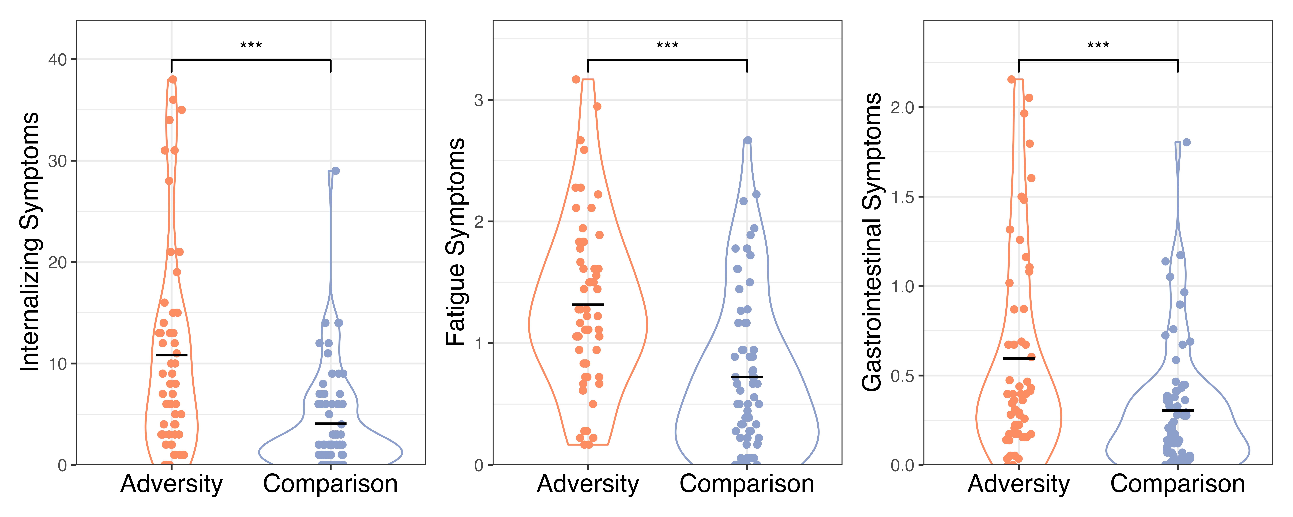
Caregiving Adversity Group Had More Symptoms
N=123, Cohen’s d = 0.87
N=124, Cohen’s d = 0.88
N=124, Cohen’s d = 0.63
Notes:
First, we wanted to see whether our group of caregiving-adversity exposed children would differ from the non-exposed comparison group in terms of internalizing and commonly co-morbid physical symptoms, and we found that the caregiving adversity group had more symptoms across domains. Here you can see that the adversity group, in orange, had more internalizing symptoms on average than the comparison group, in purple. We see a similar story for fatigue symptoms and gastrointestinal symptoms. These effects are medium to large.
The question is, does looking at functional potential of the gut microbiome help explain these differences?

Slide 6
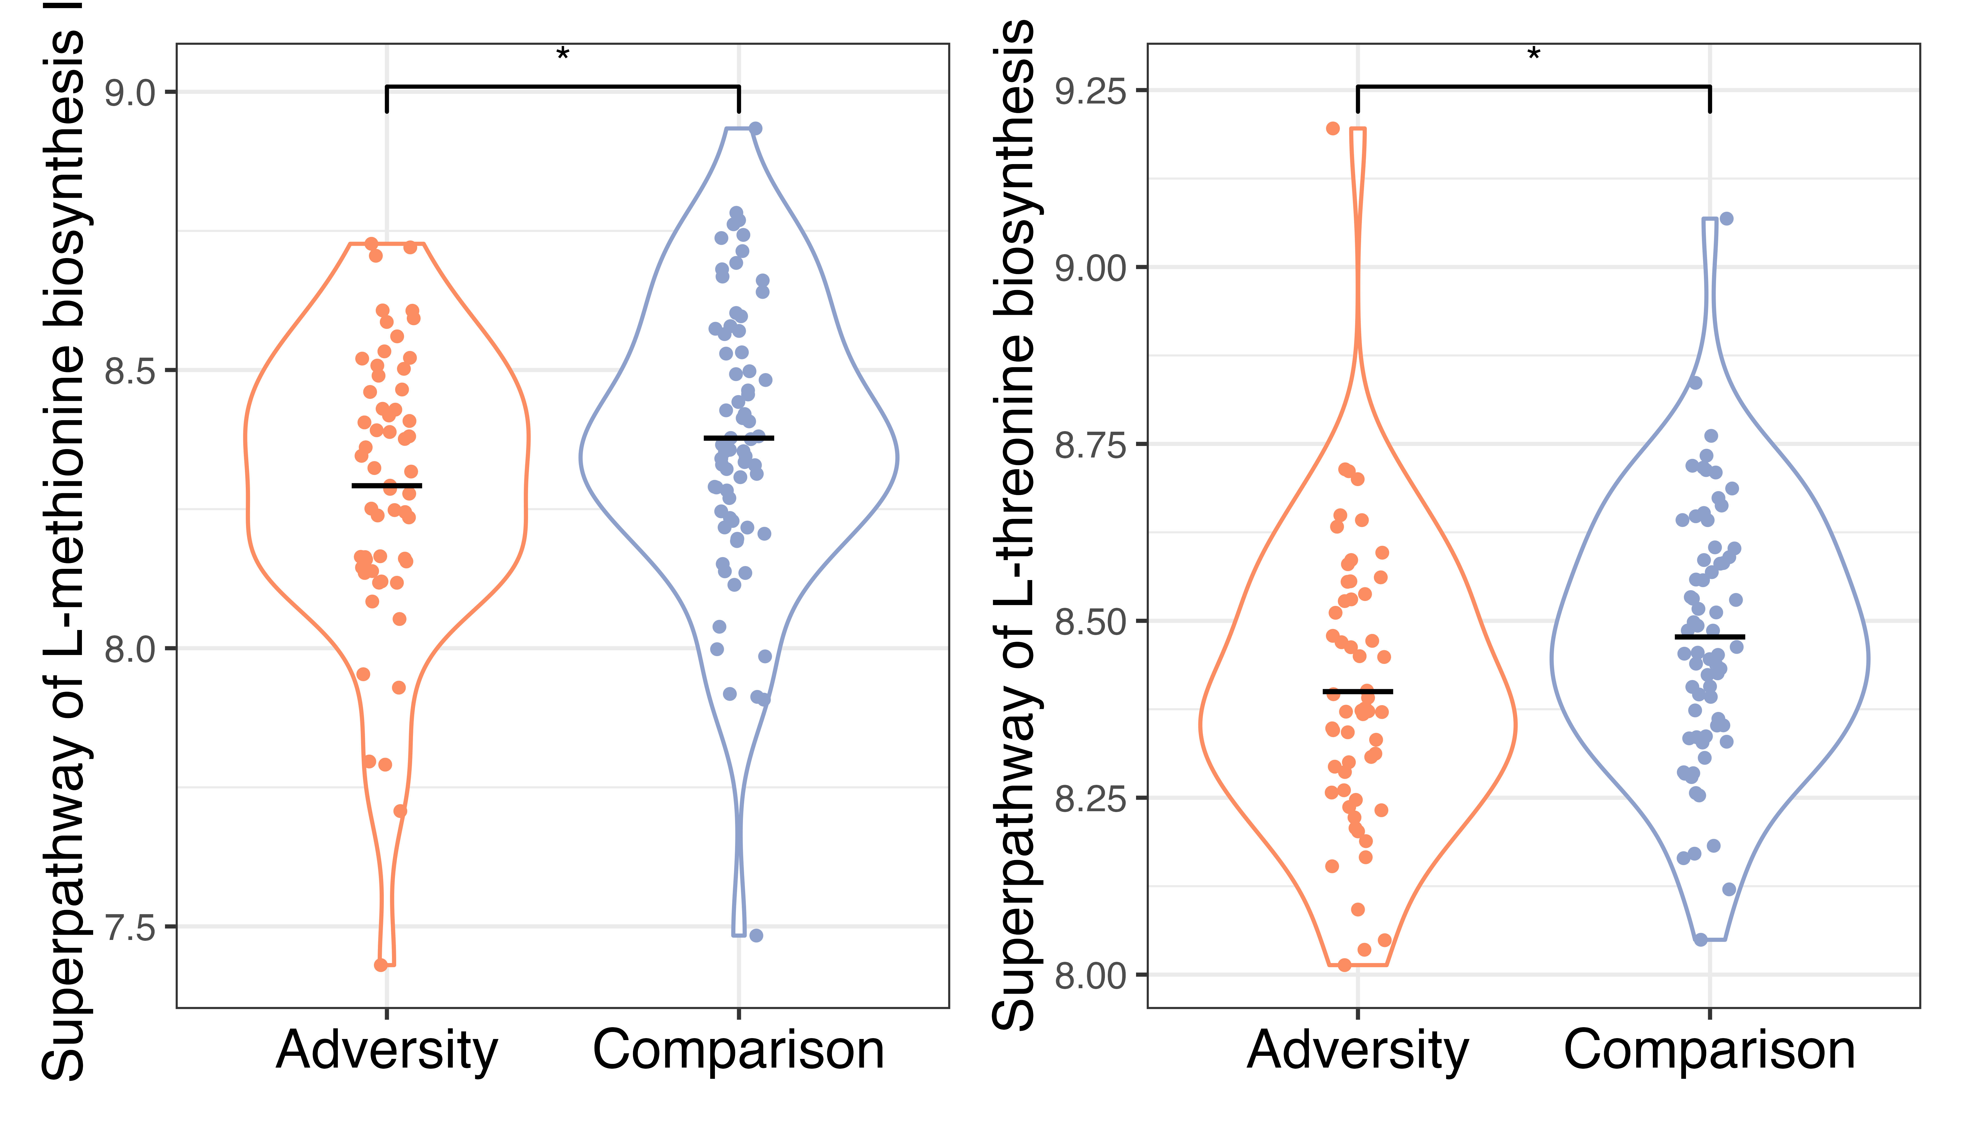
Caregiving Adversity Group Had Lower Potential for Amino Acid Synthesis Superpathways
II
N=125, Cohen’s d = 0.34
N=125, Cohen’s d = 0.40
Notes:
Looking at gut microbiome functional potential, one of the things we found was that the caregiving adversity group had lower potential for two amino acid synthesis superpathways after correcting for multiple comparisons among superpathways tested. The first was methionine, as you can see here. The second was threonine. These small to medium effects were significant controlling for child age, sex, early-life antibiotic exposure, early-life breastfeeding history, and birth methods. There were no interactions with age. So what could this mean?

Slide 7

Development
vs.
L-threonine
L-methionine
Xie et al. (2021); Averina et al. (2020); Hollister et al. (2015); Slyshenkov et al. (2002); Peterson et al. (2022)
Notes:
Well, both threonine and methionine can have neuroactive effects: methionine can protect against free radical damage in the brain, both can be used to synthesize short chain fatty acids, and threonine is a precursor to serotonin synthesis. Interestingly, compared to healthy adults, children have enriched potential for amino acid metabolism which is thought to be because amino acids are important for the brain development that occurs in childhood. So maybe the gut microbiome in the adversity group appears more similar to adults. These pathways were not related to symptoms, suggesting that perhaps the functional potential of the microbiome may potentiate future health risk but doesn’t serve to explain the positive relationship between adversity and symptoms seen in this age group.

Slide 8
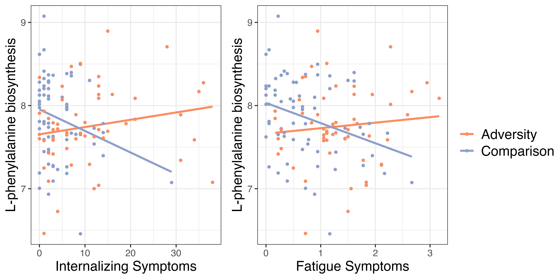
Relationship between Phenalynine Biosynthesis and Symptoms Only Present in Comparison Group
n.s.
n.s.
*
*
Notes:
Interestingly, we also found some pathways, including the phenalynine biosynthesis pathway, were differently related to symptoms in adversity-exposed compared to comparison children. Phenylanine is a precursor for dopamine synthesis, and can cross the blood brain barrier to influence dopamine levels in the brain. You can see here that for the comparison group, in purple, there is a negative relationship between internalizing symptoms and phenylamine synthesis, while there is no relationship in the adversity-exposed group (in orange). We saw the same thing for fatigue symptoms. The pattern in the comparison group is what we would expect based on rodent studies that find lower levels of phenylaline and potential for phenylaline synthesis in rats who received a fecal microbiome transplant from depressed humans. At this point, it’s not clear to us why we don’t see the same relationship in the adversity-exposed group, though there is evidence that adversity may alter communication between the brain and other peripheral systems such as the immune system.

Slide 9

Take-home Messages
Adversity group has lower potential for synthesis of amino acids which play a role in brain development & functioning
Adversity-associated pathways were not related to symptoms
Adversity may alter communication between the brain and gut microbiome
Future directions: brain data, longitudinal trends
Notes:
CA-associated pathways were not related to symptoms, suggesting gut microbiome functional potential does not serve to explain the CA-group differences in symptoms we see at this age. Perhaps differences in gut microbiome will have implications for health later in development. Or, the gut microbiome may not have direct effects on symptoms but but may be part of a complex causal pathway involving the brain or other physiological systems.
Our findings that some relationships between gut microbiome functional potential and symptoms were different across adversity exposure groups suggests that adversity may alter…
Given that some of our findings were in pathways with neuroactive outputs, one of next steps is to integrate gut microbiome with brain data that we have in this sample, including functional connectivity and neuromelanin scanning which provides a proxy for dopamine function. We will also examine longitudinal data in this cohort to see if gut microbiome functional potential predicts changes in symptoms across time.
We only had time to discuss a subset of our findings; for all of them, please refer to our GLMC poster. A QR code is included on the last slide!

Slide 10
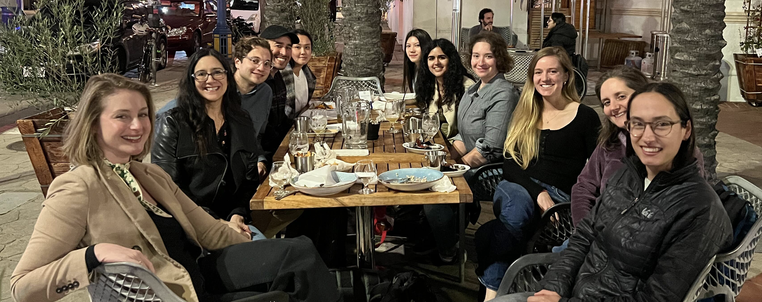

Acknowledgements
Brain and Body Lab
Mind, Brain, Body Study Research Team
Participating Youth & Families
Funding: Goodman-Luskin Microbiome Center Seed Fellowship, NIMHT3215750
Notes:
With that, we’d like to thank the brian and body lab, who are shown here, the research team for this study who worked tirelessly to make this project possible, the youth and families who participated, and our funding sources, including a seed fellowship from the goodman-Luskin microbiome center!

Slide 11

Thank you!
QR code to poster with full results
Notes:
Thank you all for listening
ADD QR CODE TO POSTER

